Slide 1
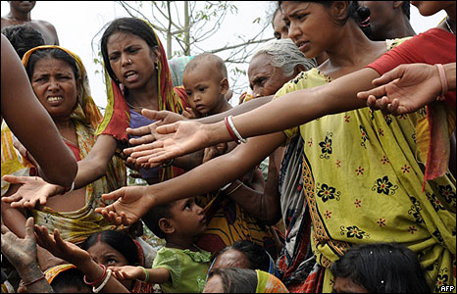
FEED ME!

Slide 2
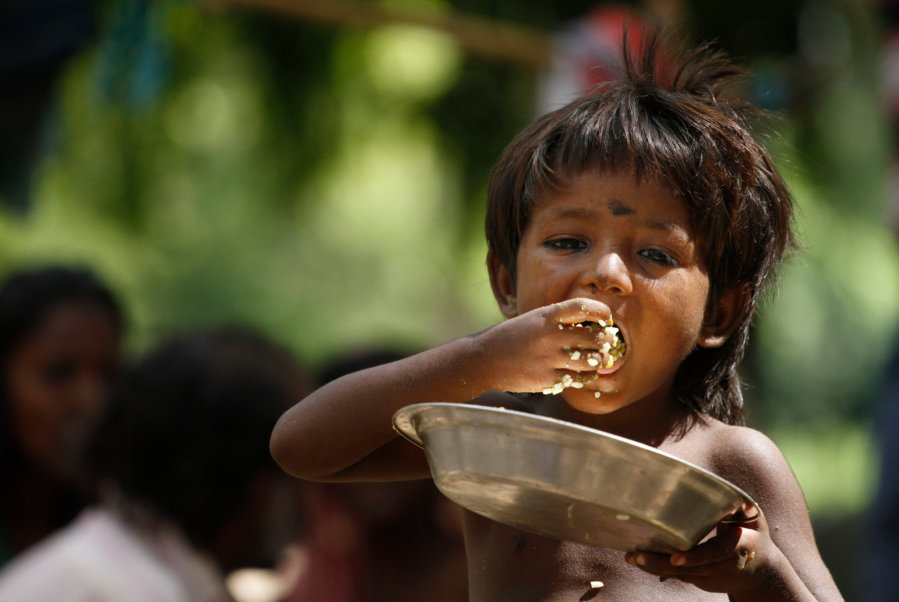
With a score of 28.7 in the 2023 Global Hunger Index(GHI), India has a level of hunger that is serious.

Slide 3
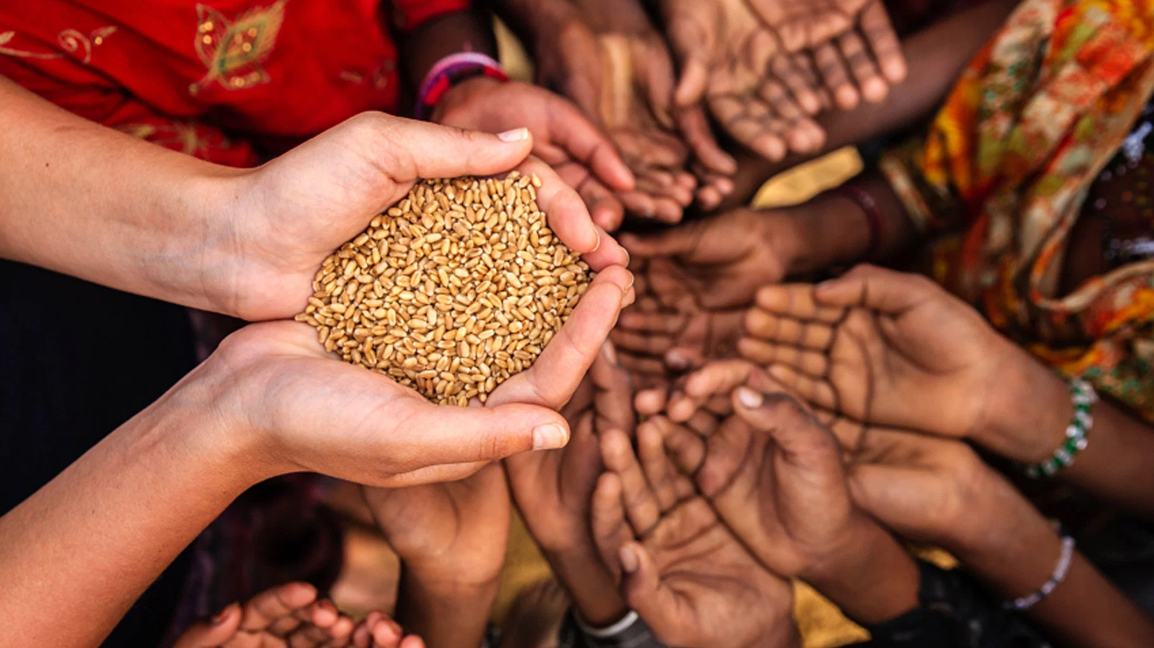
JUST FEELING SAD ABOUT THEM DOESN’T SOLVE THE PROBLEM
LET’S HELP THEM

Slide 4
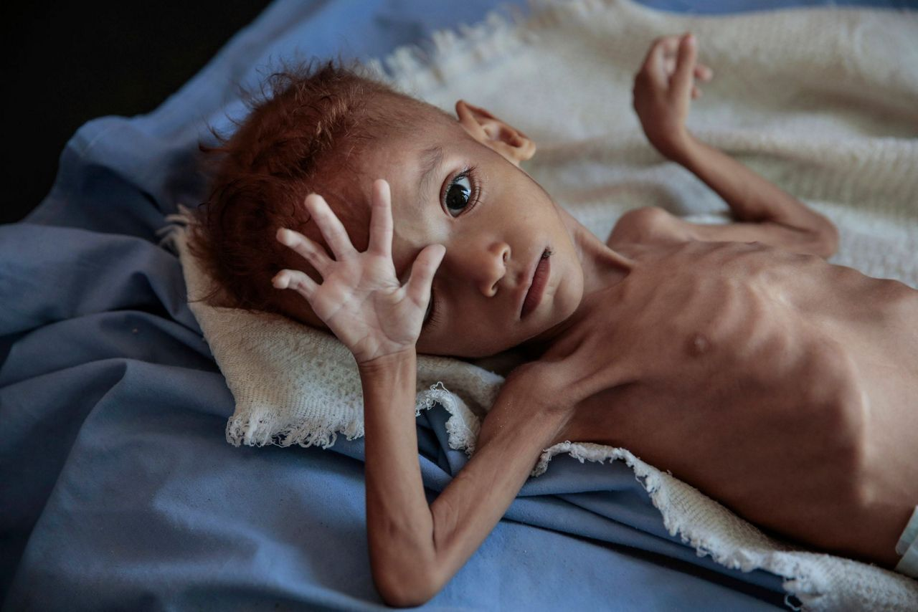
We intend to build an app which collects money from the people who are interested to donate.This app acts as a mediator between the people who want to help and the people who are in need.

Slide 5

DOANTE AS MUCH AS YOU CAN!

Slide 6
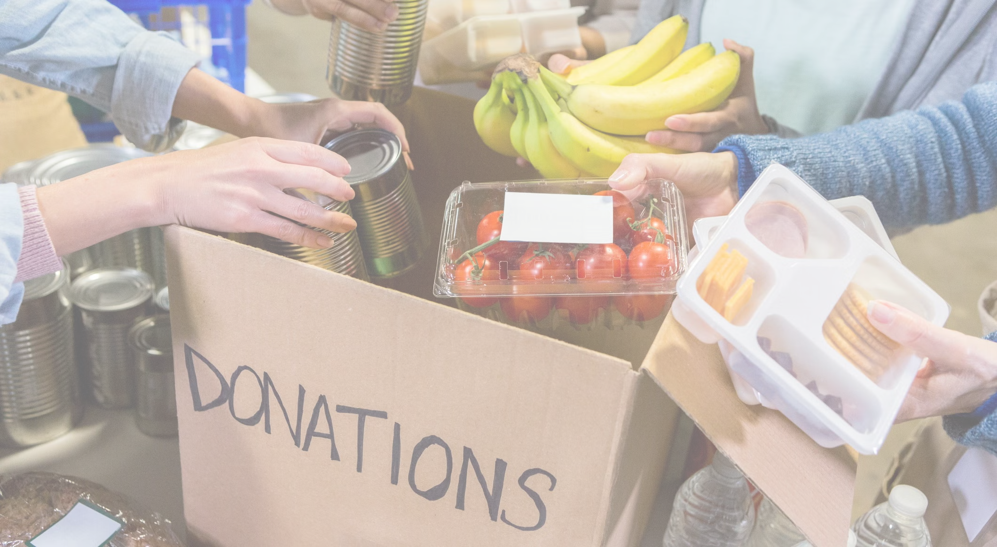
THE COLLECTED FUNDS ARE GIVEN TO FOOD DONATING ORGANISATIONS TO EXTEND THE REACH

Slide 7

AFTER THE APP IS KNOWN BETTER TO PEOPLE AND THE FINANCIAL SUPPORT IS GOOD,WE GIVE DIRECT CONTRACTS TO RESTRAUNTS FOR FOOD AND EMPLOY PEOPLE FOR FOOD DELIVERIES

Slide 8
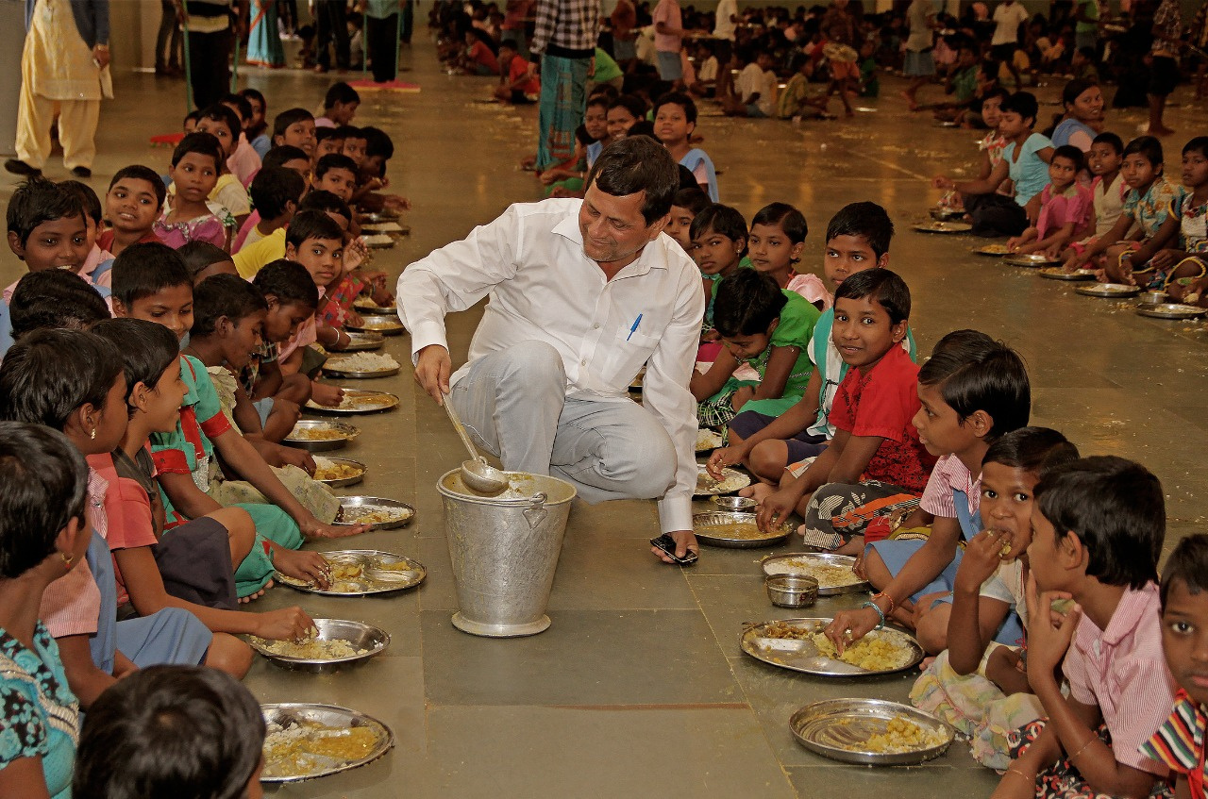
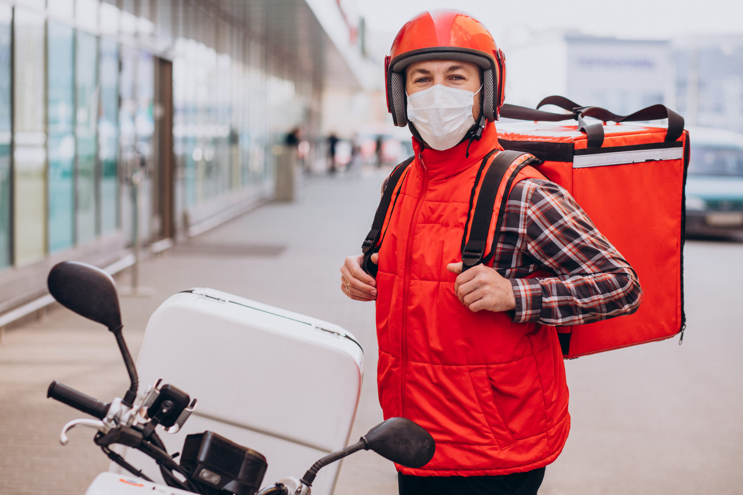
WE CAN SEE DEVELOPMENT IN BOTH THE DOMAINS

Slide 9

SERVING HUMANITY WITH TECHNOLOGY

Slide 10

OUR UNITY IS OUR STRENGTH!
Let us step forward for the people in need

Slide 11
THANK YOU!!

